Slide 1
Algorithms: Efficiency, Analysis, and Order

Slide 2
Goals
Algorithm definition
Define growth rate of an algorithm as a function of input size
Define worst case, average case, and best case complexity analysis of algorithms
Classify functions based on the growth rate
Define growth rates: Big O, Theta, and Omega
Define space complexity

Slide 3
Definition of “Problem”
A problem is a well-defined task or question that we seek a solution for
Example: Could we find if number X exists in a list S with n elements?
the answer is yes/no
The problem has 3 parameters: S, X, n
We need deterministic general algorithm to find answers for any arbitrary sized input

Slide 4
Problem Instance
A problem with particular parameters is called a “problem instance”
Find X=12 in S=[5, 3, 7, 2, 5, 42], n=6

Slide 5
What is an Algorithm?
An algorithm is a step-by-step approach to solve a problem
Several solutions (algorithms) to solve a problem
We like the fastest one!
We like the efficient one (minimum CPU and memory)
Generally, the efficiency an algorithm is related to number of steps (time complexity) or volume of memory (space complexity).
How to analyze algorithms in terms of time and space?

Slide 6
Human-based Solutions vs Algorithms
Human mind can solve some problem instances very efficiently:
Sort S=[3, 4, 2, 5, 1]
But our mind solution cannot scale!
Sort S=[4, 6, 12, 7, 43, 3, 7, 97, 23, 56, 754, 43, 245,…]
Our solution cannot cover all problem instances!
Alternatively, an algorithm for a problem must be able to solve all instances of a problem!

Slide 7
Presenting an Algorithm
We can use natural languages
It is not accurate and sometime vague!
We generally use pseudo-code to present algorithms
Algorithms are language independent
We will use C/C++/Python pseudo code just to present algorithms

Slide 8
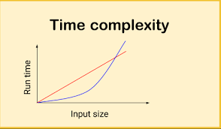
How much time does an algorithm take to run?
Depend on different factors:
How fast is the computer?
Are you running other programs at the same time?
So, we should change the question to:
How does the running time grow as the size of input grows?

Slide 9
Analyze the Time Efficiency of an Algorithm: First Attack!
It is also known as time complexity analysis of an algorithm
To know the time of an algorithm, we should count the number of instructions executed on the CPU
Let’s do an example…

Slide 10
Linear vs Binary Search
Assume:
List S with size n
Searching for x ∉ S
Using linear (sequential) search: n comparison
Using binary search: logn +1 comparison
If n=9 in binary search, we have 4 comparisons

Slide 11
How Number of Comparisons Can be Important!
The number of comparisons is a function of “list size”
List size | Comparisons in Sequential | Comparisons in Binary
128 | 128 | 8
2^10= 1024 | 1024 | 11
2^20=1048576 | 1,048,576 | 21
2^30= 4294967296 | 4,294,967,296 | 31

Slide 12
Analysis of Recursive Functions
int power (int x , int n) { if (n==0) return 1;
if (n==1)
return x;
return x * power(x , n-1);
}
T(n) = T(n-1) + 3
T(1) = 2 (or we can say c in general)
What is the close form complexity function for it?

Slide 13
Analysis of Recursive Functions
int foo (int a , int n) { if (n==1)
return 0;
return a + foo(a , n-1) * foo(a , n-1);
}
T(n) = 2 T(n-1) + c T(1) = 1
Exercise: What is the close form complexity function?

Slide 14
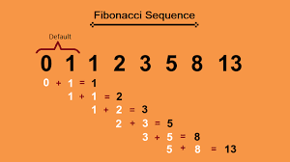
Fibonacci Series: Iterative vs Recursive
Consider the algorithm to obtain the n^{th} element of the Fibonacci series
f₀=0
f₁=1
f_{n}= f_{n-1} + f_{n-2} for all n≥ 2
int fib (int n) { if (n==0) return 0;
if (n==1)
return 1
return fib(n-1)+fib(n-2);
}

Slide 15
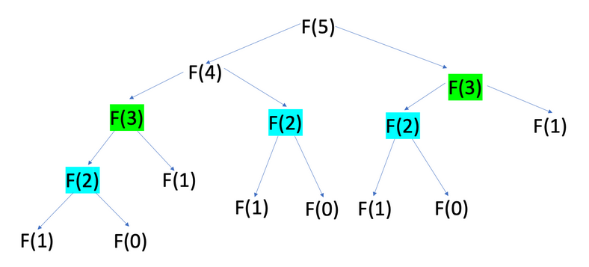
Time Complexity Function of the Fibonacci Algorithm?
The decisive factor on the time complexity of this method is the number of times other functions are invoked.
At each iteration, 2 functions are called

Slide 16
Analysis of the Fibonacci Algorithm
What if we extend the tree for Fib(6)?
The whole current tree will be augmented by Fib(4)
This means ~1.5 times bigger tree than Fib(5)
This means more than 2 times than Fib(4)
Sub-tree of Fib(4) will be added to the right side
T(n) > 2 × T(n -2) → T(n) > 2 ^{n/2}

Slide 17
Iterative Approach for Fibonacci
We do not need to recalculate everything!
Once we calculate one fib(X) we can use it to calculate fib(X+1)
We just need to store the value
In this case, the complexity of the algorithm is n+1

Slide 18
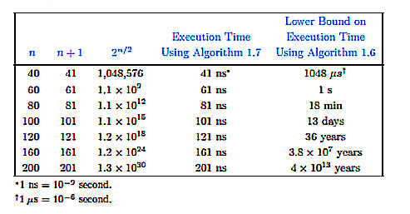
Comparing the Two Approaches
(Iterative)
(Recursive)
1
2
The two implementations are based on different algorithm design patterns .

Slide 19
Complexity Analysis of Algorithms: Second Attack!
We do not need to count all instructions to analyze the efficiency of an algorithm
The number of coded commands depends on the programming language, programmer, compiler,…
Alternatively, we find and count the number of times basic operations are executed
basic operations generally is a function of the input size
Example: size of array (n) in a binary search
How to determine the basic operation?

Slide 20
Is it always Input Size?
Complexity of algorithms “generally” is a function of the input size
Summing elements of an array with size n
Sorting array with size n
Sometimes we have more than one important input size:
Checking connectivity of a graph depends on the number of vertices (n) and edges (m)
Sometimes complexity is function of output size
Finding Fibonacci series for input n

Slide 21
How to Do Complexity Analysis?
We should figure out the relation between the input size and the number of times basic operations executed
We should answer this question:
When input size increases how the number of basic operations executed increases? (Linear, Logarithmic,…)
T(n) is the number of times a basic operation is executed for a given input
It is called usual (normal) complexity of an algorithm

Slide 22
Examples of T(n)
Summing elements of a list:
basic operation: sum
Input size: n (list size)
T(n)=n
Bubble sort complexity analysis:
basic operation: comparison statement of s[i] and s[j]
Input size: n (list size)
T(n)=n²+n-1

Slide 23
Does T(n) Exist for All Algorithms?
NO!
Many algorithms do not have usual time complexity
Example: Binary search
We still can analyze these algorithms
W(n): worst case time complexity
A(n): average case time complexity
B(n): best case time complexity

Slide 24
Worst Case Time Complexity Analysis: an example
For linear search:
Worst case is when the searching element is in the last cell of the list or does not exist in it
W(n)=n

Slide 25
Average Case Time Complexity (A(n))
We are interested in the “expected” complexity of an algorithm
Expected number of times the basic operation is executed
Calculating A(n) entails probabilistic analysis of algorithms that is very complicated!
We should know the probabilities of different cases happen in the input
Example: distribution of numbers in a list can be assumed to be uniform

Slide 26
Average Case Complexity: an example
Consider the linear search example
basic operation: comparing list elements with X Input size: n (list size)
If we know that X exists in the list
Probability of finding X in each cell is 1/n
If we do not know that X exists or not
Let’s assume that the probability of X exists is P
The probability that it does not exist is 1-P

Slide 27
Best Case Time Complexity B(n)
It indicates the minimum number of times the basic operation is executed
Best Case complexity of linear search
B(n)=1
If T(n) exists for an algorithm (the usual time complexity):
W(n)=A(n)=B(n)=T(n)

Slide 28
Which Analysis is More Useful?
Average case analysis is the best
It is very difficult to calculate
It requires meta-data about input data that we may not have prior to execution
Worst case analysis is also useful
Especially in critical algorithms
Example: An algorithm that controls a reactor
Best case is the least valuable type of analysis

Slide 29
Overhead and Control Instructions in an Algorithm
Overhead instructions
Instructions that their number of execution times is not a function of input size
Example: initializations of variables, instructions outside loops
Control instructions
Instructions that their number of execution times is a function of input size
Example: increment within the loop

Slide 30
Role of Overhead and Control Instructions in Complexity Analysis
Assume that to solving a problem, there are two algorithms with complexities:
n × 1000 t
n² × t
t is the time for running an instruction in the computer
Which algorithm is more efficient?
How about if the input size is 5, 10, 200, and 4000?
n>1000

